Slide 1
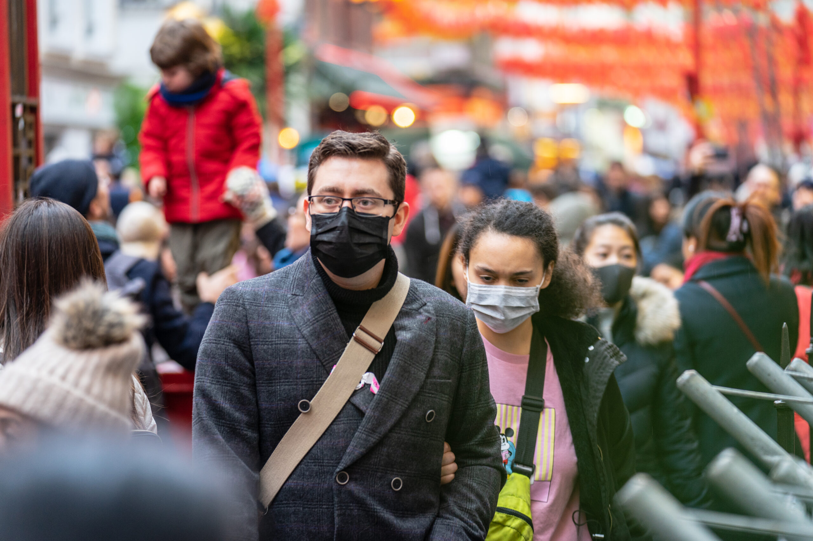


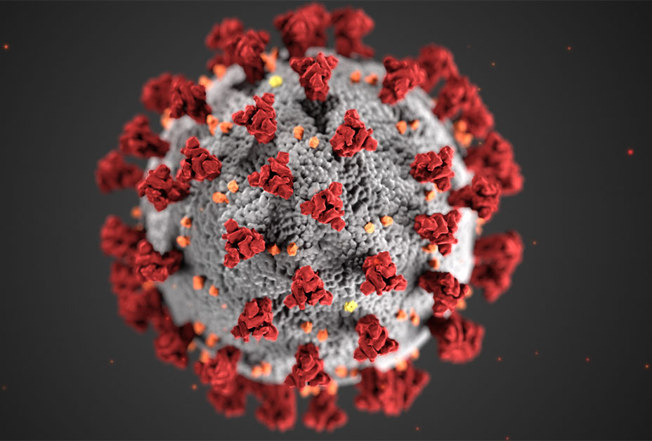

Novel Corona Virus
Presented By:
Rohan Naga Venkata Mayukh Ungarala
Student ID: 016000127
DATA 230: DATA VISUALIZATION
06 December 2022
Under Guidance of Prof. Andrew Bond

Slide 2


Here’s What’s Coming
Introduction
Datasets
Methods
Visualizations
Demo
Key learnings
Let’s go!

Slide 3
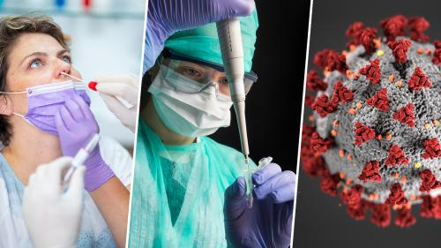

What is covid 19?
COVID-19 is an infectious disease caused by the recently found virus known as SARS-CoV-2 (or coronavirus). Before the outbreak originated in Wuhan, China in December 2019.
The symptoms of the COVID – 19 were Fever or chills, Cough, Shortness of breath or difficulty breathing, Fatigue, Muscle or body aches, Headache, New loss of taste or smell, Sore throat, Congestion or runny nose, Nausea or vomiting and Diarrhea.
Precautions practiced were social distancing, frequent sanitization, wearing a high-quality mask.

Slide 4

Dataset
Novel Corona Virus 2019 Dataset
Contains data from the year 2020 to present (2022)
Dataset was taken from the Kaggle.
205,951 records and 10 fields.
The columns in the dataset are Observation Date, Province/State, Country/Region, Confirmed, Deaths, Recovered, etc.
Location: Global Map
Since the data contained is voluntarily reported, there is some noisy data is present on dataset.
Tableau automatically prompts to use Data Interpreter to clean the data.

Slide 5

Methods
The large number of null and unknown values that skewed the query results. For example, cleaning the dataset was done by excluding null values and unknowns as necessary.
The dataset Covid was taken from Kaggle and then connected to Tableau.
Some data transformations was implemented for the effective visualizations.

Slide 6

Visualizations

Slide 7
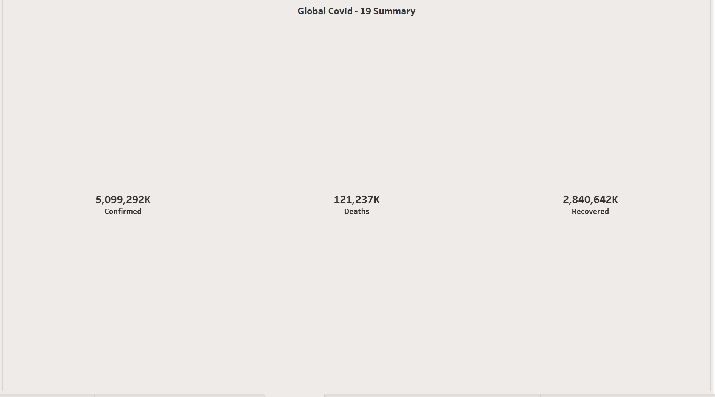
GLOBAL COVID SUMMARY

Slide 8
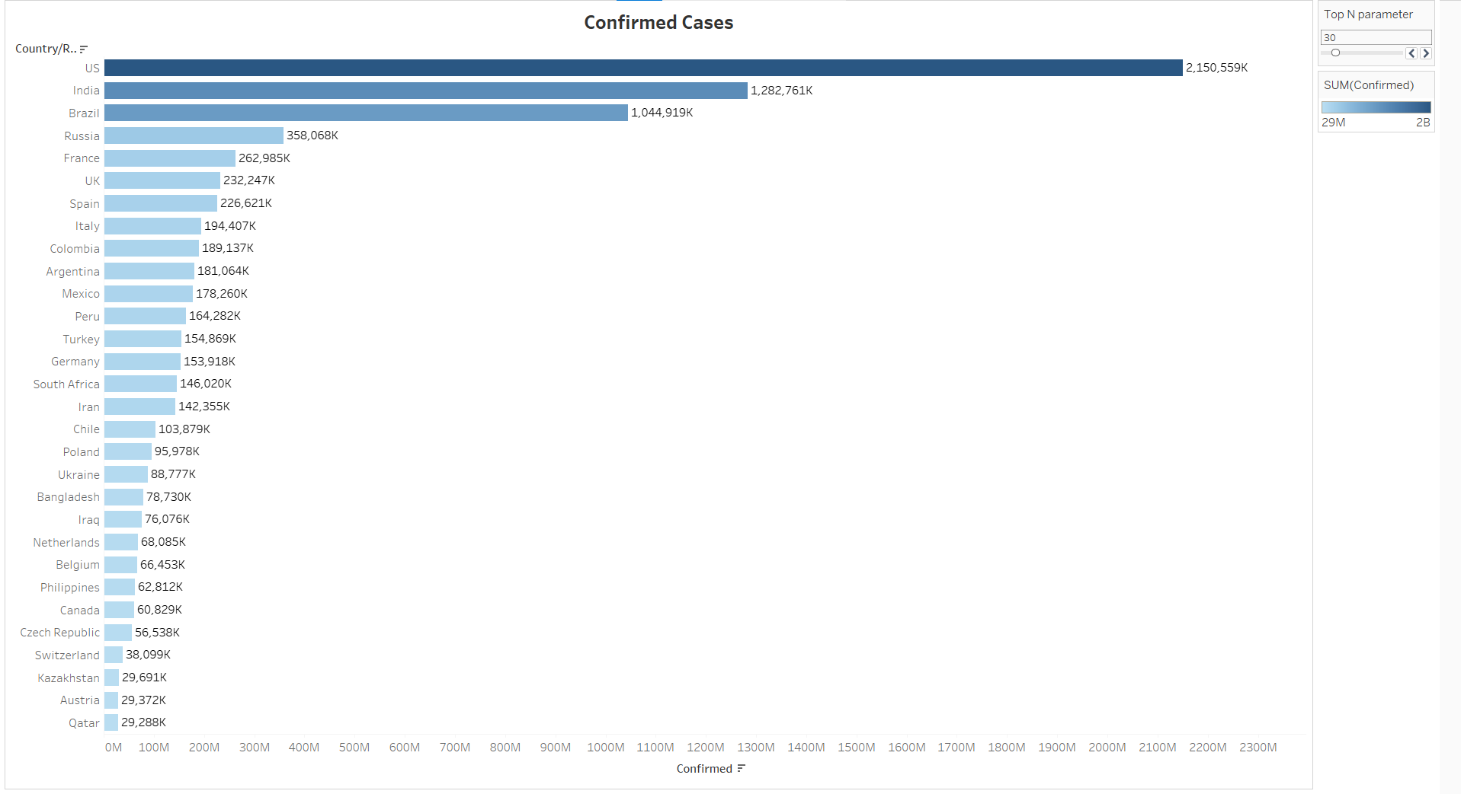
GLOBAL CONFIRMED CASES

Slide 9
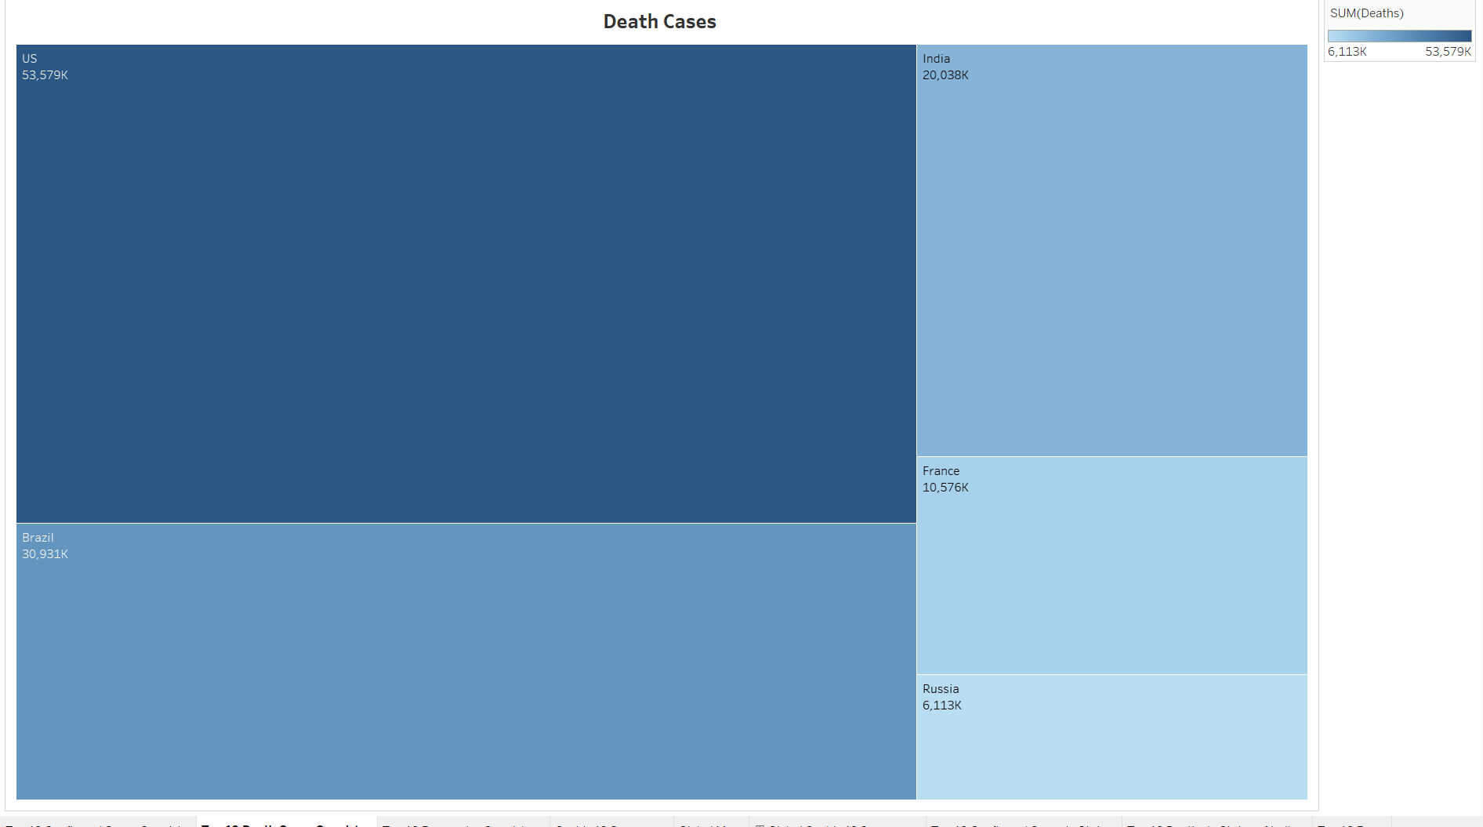
GLOBAL DEATHS

Slide 10
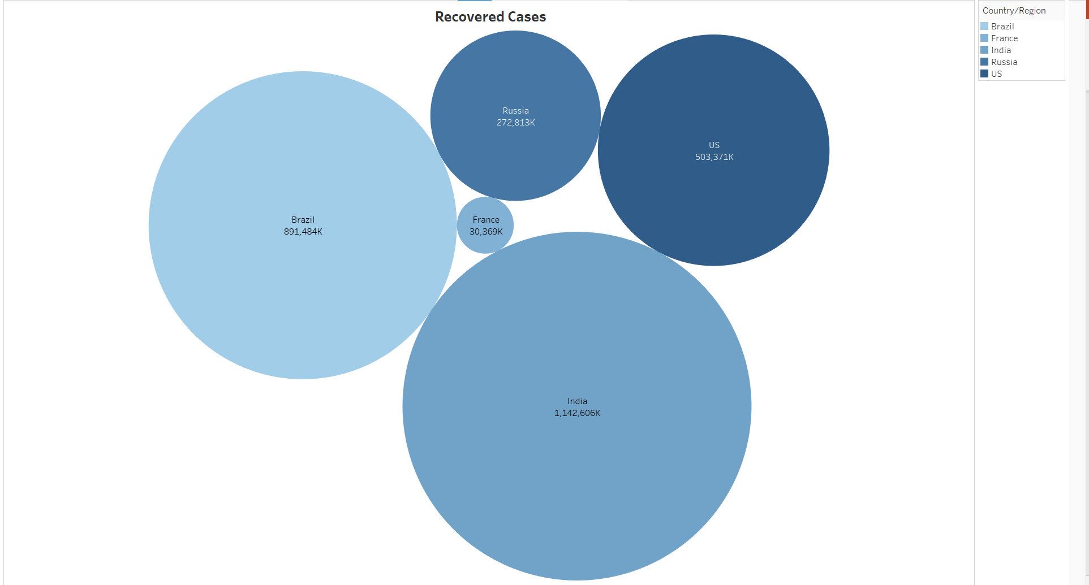
GLOBAL RECOVERY CASES

Slide 11
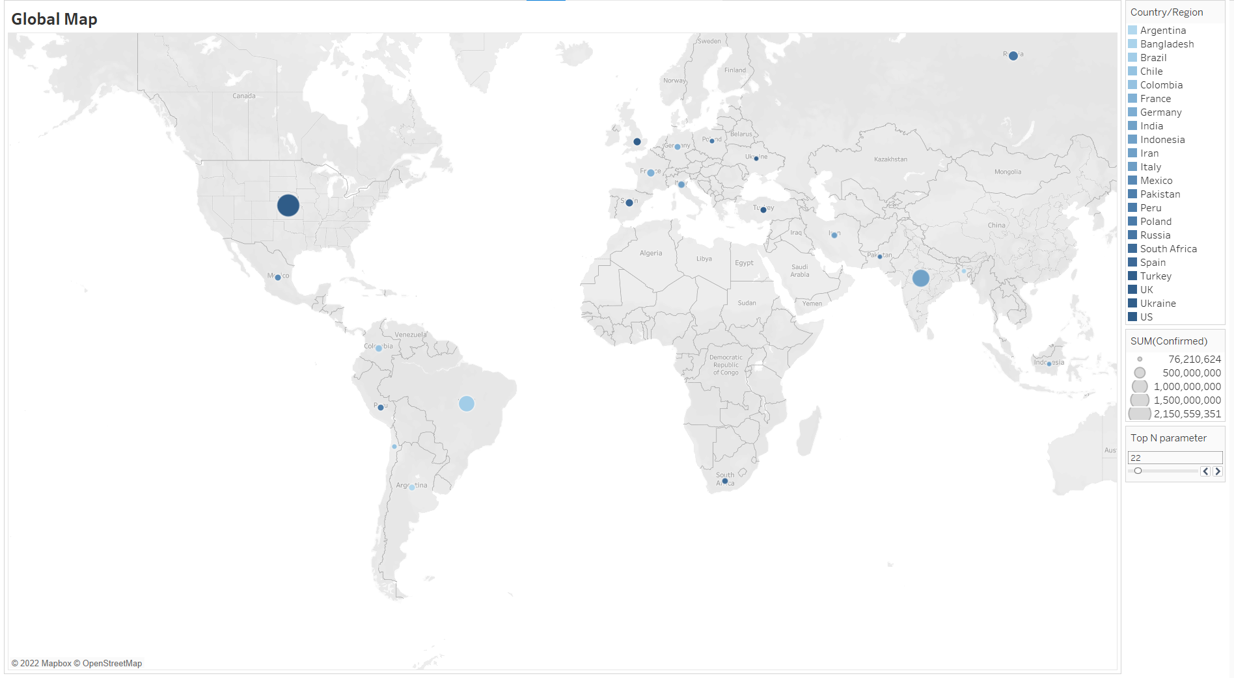
GLOBAL MAP

Slide 12


Slide 13
Key takeaways
From the data, the country with the highest probability of confirmed cases is theUS and then the Mozambique country having the least probability of confirmed cases.
November through February were the most popular months for getting effected because during these months, winter would be in peak which leads to get more chances of cold, cough, throat pain which are symptoms of Covid.
India has the highest recovered cases because the vaccination drive started earliest and continuing at rapid speed then followed by Brazil.
Weather conditions, no masks, no social distance, no proper hygiene which were one of the main reasons for rise in Covid. However, the implementation of strict lockdowns and increase in vaccination drives in these cases ease down the Covid cases and came under control.

Slide 14


